Slide 1
Microsoft Project 2007
Further on Resource and
Fine Tuning Assignment Details

Slide 2
Course Objectives
Resource Details
  Defining multiple pay rates
  Applying multiple cost rates
  Setting up resource availability
  Assigning variable consumption rates to material resources.
Tuning Assignment Details
  Delaying the start of a resource assignment.
  Using work contours to schedule work.
  Applying a predefined work contour to an assignment
Notes:
Critical Path, Fast tracking and Crashing

Slide 3

Introduction
During project life cycle, various situations may arise…
  Resources are not available during certain times
  Cost of the resources increases during the project
  A resource may be assigned to two or more tasks and that resource might be paid at a different rate for each task.

Slide 4
Multiple Pay Rates
Different tasks different rates
  A Senior Developer is playing a double role as a designer and as a developer
  Design work - Rate: $25
  Development work - Rate: $20
  The resource effort and cost for different tasks should be orrectly reflected in the project plan
  You can setup up to five pay rates for each resource.
Rates changes after a certain date
  Your pay rates slabs are experience based
  Experience 1 - 2 year – Grade A – Rates: $18
  Experience 3 – 4 years – Grade B – Rates: $20
  A resource moves to higher grade on a certain date. You need to specify the date on which resource moves to next grade and the pay rates should automatically change on the dates that you specify.
  You can set up a maximum of 25 different pay rates for each of the five pay rate tables

Slide 5
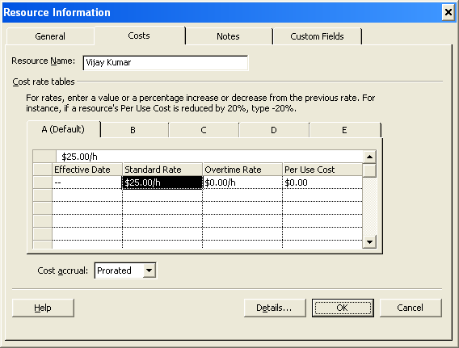
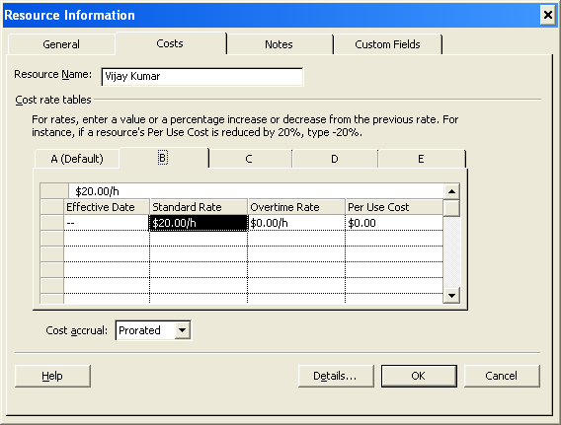
Multiple Pay Rates (Rate Table)
To set up multiple pay rates for a resource, perform the following steps:
  Choose the Resource Sheet View from view list
  Select the resource and click the Resource Information button.
  Select the table you want to use—B, C, D, or E, on Cost Tab of Resource Information dialog box (By default, the table A (Default) is selected)
  Type the new rate in dollars in the first row of the Standard Rate column to specify the new pay rate
  Repeat steps 3 and 4 to create additional cost rate tables for the resource
  Click OK to finish

Slide 6
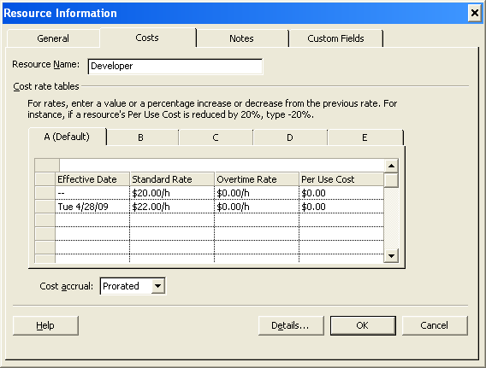
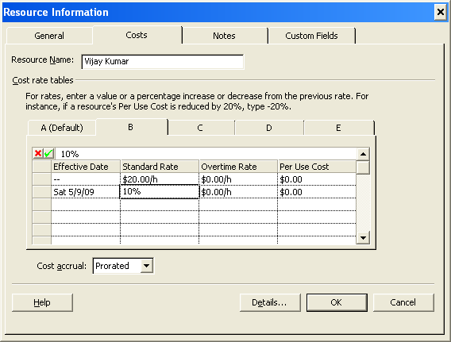
Multiple Pay Rates (Effective Date)
To set up multiple pay rates for a resource, perform the following steps:
  Choose the view Resource Sheet view from view list
  Select the resource and click the Resource Information button.
  Select the table you want to use—B, C, D, or E, on Cost Tab of Resource Information dialog box (By default, the table A (Default) is selected)
  Type the new rate in dollars or in % of original pay rates in the second row (or lower) of the Standard Rate column to specify the new pay rate.
  Use negative sign with % if you want to specify rates less than original rates i.e. -10%
  By default effective date is today’s date. Change it if effective date is different
  Repeat steps 3 and 5 to create additional cost rate tables for the resource

Slide 7
Applying Different Cost Rates to Assignments
By default, rate table A is used for all cost calculations. If you want to use a different cost rate table for a particular assignment, you need to apply the specific cost rate table to that assignment.
To apply a previously created cost rate table to an assignment, perform the following steps:
  To change the view to Task Usage.
  Look for the assignment for which you want to change the rate table and click the name of the resource for that assignment in the Task Name column
  Click the Assignment Information button or just double click the resource name for Assignment Information dialog box
  Select the required cost rate table in Cost rate table list box on General Tab in the Assignment Information dialog box
  Click OK to close the Assignment Information dialog box,
  To view Cost Rate Table in Task Usage view, insert Cost Rate Table column by right clicking header part and selecting Insert Column in context menu and then on Column Definition dialog box, selecting Cost Rate Table in Field Name

Slide 8
Setting Up Resource Availability
Project 2007 uses this information about availability of resource to calculate the amount of time the resource will take to complete the assigned task.
By default, resource is available full time on all working days
You can record resource availability by specifying the dates that the resource is available. Using this feature you can handle part time resources
Follow below steps to change resources availability
  Change the view to resource sheet.
  Select the required resource, and then on the Standard toolbar, click the Resource Information button.
  To specify the start date of the assignment, in the Resource Information dialog box, on the General tab, under Resource Availability, in the first cell of the Available From column, select the start date. and select the end date of the assignment in the first cell of the Available To column.
  You can specify the start and end dates of the second assignment. Enter the required start date in the second cell of the Available From column and end in second cell of the Available To column
  To change work capacity of the resource, in the Units column, in the second row, type the required percentage, and press ENTER.

Slide 9
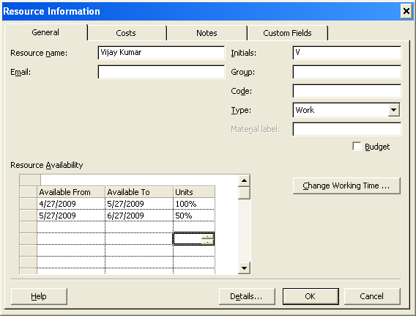
Setting Up Resource Availability

Slide 10
Consumption Rates for Material Resources
For material resources, the Units or Assignment Units field indicates the material consumption rate. The rate is specified in number of units of material that is required for the assignment or rate of consumption at which rate is being consumed
There are two types of consumption rates that you can assign for material resources
  Fixed
    If the number of units of the resource required remains the same regardless of the task duration and the length of the assignment
    Ex. We know the data size so number of DVDs to be consumed are fixed irrespective of backup task duration
  Variable
    If the number of units of the resource required is based on the duration of the task to which the material resource is assigned.
    Ex. We do not know the size of the data and server writes data of size of 1 DVD every day. If backup task runs for 5 day will consume 5 DVDs and if it runs for 10 days, it will consume 10 DVDs

Slide 11
Assigning Variable Consumption Rates
Follow below steps to assign a fixed or a variable consumption rate for material resources
  To select the task for which you want to assign a material resource with a variable consumption rate, in the Task Name column, select a task.
  To access the options for setting consumption rates, on the Standard toolbar, click the Assign Resources button
  The figures in the Cost column indicate the total cost of the resource.
  When you specify the assignment units for the material resource, the Cost column is automatically updated to display the total cost of using the resource for the task
  To set the consumption rate, in the Units column corresponding to the assigned resource, type a consumption rate, and then press ENTER.
  To change the duration of the task, in the Gantt Chart view, in the Duration column corresponding to the selected task, type the new duration, and then press ENTER.
  To close the Assign Resources dialog box, click Close.

Slide 12
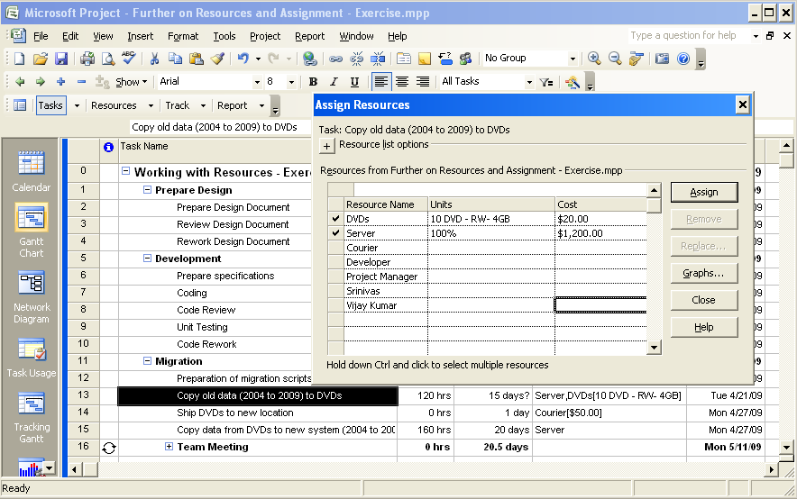
Assigning Variable Consumption Rates
Fixed

Slide 13
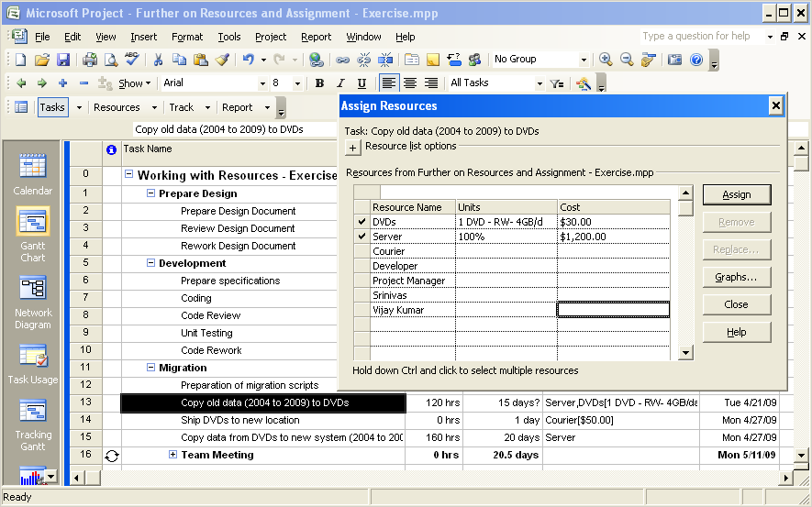
Assigning Variable Consumption Rates
Variable

Slide 14
Question
How many maximum pay rates can you create to apply at different times for a pay table
Select the one best answer
  20
  25
  15
  10
  ✓

Slide 15
Question
For which of the following tasks, the multiple cost rate tables can be used?
Select the one best answer
  Tabulating and comparing the cost of material resources
  Tabulating and comparing the cost of work resources
  Comparing the pay rates of resources
  Setting up different pay rates for a single resource
  ✓

Slide 16
Course Objectives
Resource Details
  Defining multiple pay rates
  Applying multiple cost rates
  Setting up resource availability
  Assigning variable consumption rates to material resources.
Tuning Assignment Details
  Delaying the start of a resource assignment.
  Using work contours to schedule work.
  Applying a predefined work contour

Slide 17
Tuning Assignment Details
Let’s review following situations
  A resource who is assigned to a task might begin work later than other team members due to unavailability
  The productivity of a new resource may be lower the first few days of an assignment
  A resource may work for a few hours at the start of the task, increase the number of hours during the course of the project, and then work for a few hours until the task is completed
  A Resource is available fully in the beginning and later he is available partially

Slide 18
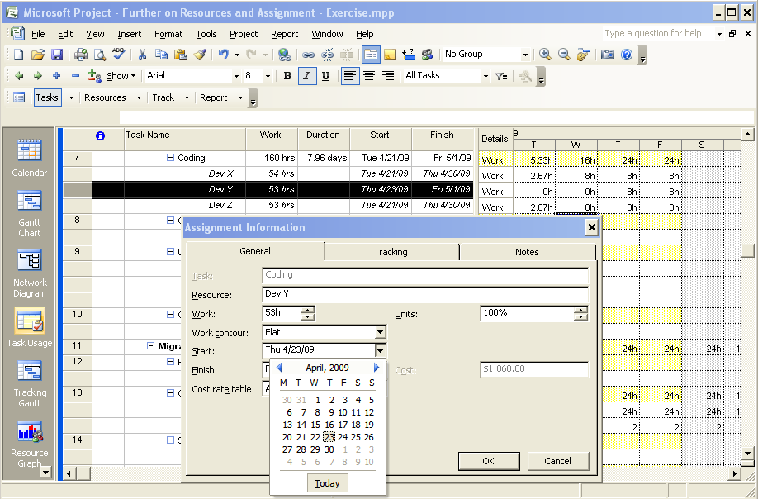
Delaying the Start of an Assignment
Change the view to Task Usage
Locate the task and select the resource in Task Name column for which assignment is to be delayed
Click on Assignment Information button on Standard Toolbar or just double click resource name to get Assignment Information dialog box
On General Tab, change the Start Date and click OK
Notes:
Show by changing Developer with Dev X, Dev Y & Dev Z and then delaying start date of Dev Y

Slide 19







Work Contours
By default when a work is allocated to a task, work is distributed evenly across the duration of the task. It may not match with the way the work is actually getting executed.
You may work few hours at the start and gradually increase the hours over a period or you may work full hours in beginning but later reduce it
To manage such situation, work contours are provided that you can use to change the distribution of work hours over the duration of a task.
Predefined
  Back Loaded Double Peak
  Front Loaded Early Peak
  Bell Late Peak
  Turtle
Manually
  You go to the Task Usage or Resource Usage View and manually change the distribution of the work by editing number of allocated hours each day in time scale grid

Slide 20

Distributing Work by Using Work Contours
Follow below steps to apply/reapply predefined work contour
  Change the view to Task Usage
  Locate the task and select the resource in Task Name column for which work contour is to be applied
  Click on Assignment Information button on Standard Toolbar or just double click resource name to get Assignment Information dialog box
  On the General tab in the Assignment Information dialog box, select a contour in the Work contour list and then click OK.
Follow below steps to change work distribution manually
  Change the view to Task Usage
  Locate the task and select the resource in Task Name column for which work distribution is to be edited
  Go to the right pane in the timescale grid, select the an assigned day and type new duration, and then press ENTER.
  Repeat the previous step to change the assignment of the resource for other days.

Slide 21
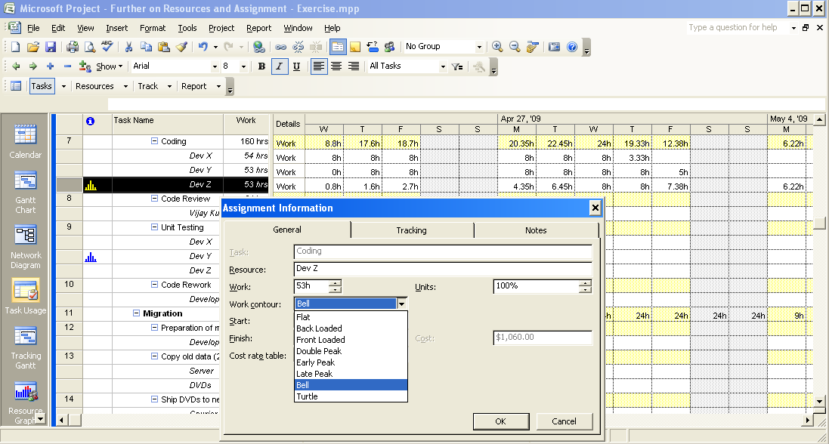
Distributing Work by Using Work Contours

Slide 22
Question
For which of the following tasks can a predefined work contours be used?
Select the one best answer.
  Determining the pattern of an assignment.
  Delaying the start of an assignment.
  Setting the start of an assignment to an earlier date.
  Distributing work over the duration of the assignment in a specific pattern
  ✓

Slide 23
Question
A task in your project has multiple resources assigned to it. One of the resources cannot start work at the same time as the others, due to a delay in the task on which the resource is currently working. Which of the following is the best method to update the project plan to reflect this situation?
Select the one best answer.
  Delay the start of the task.
  Delay the start of the assignment only for the resource.
  Create a separate task for the same activity with a different start date.
  Create a different resource calendar for the resource.
  ✓

Slide 24
Lab: Fine-Tuning Resource and Assignment Details
In this lab, you will fine-tune resource and assignment details by creating and applying task-specific and time-bound pay rates. You will also schedule resource availability manually and by using work contours. Finally, you will apply a variable consumption rate to a material resource.
After completing this lab, you will be able to:
  Set up multiple pay rates.
  Set up pay rates that apply during different time periods.
  Apply different cost rates.
  Schedule resource availability over time.
  Assign variable consumption rates.
  Apply a predefined work contour.
  Manually edit work hours on a task

Slide 25
Lab: Fine-Tuning Resource and Assignment Details
Northwind Traders is a multibrand discount retail outlet. It offers its customers a wide range of products at discounts from 25 percent to 60 percent throughout the year. As a discount retail outlet selling leading apparel and sportswear brands, the company operates on narrow margins. To streamline operation and improve efficiency, the company wants to develop an in-house application that helps manage inventory, sales, and human-resources activities.
You are the Project Manager in charge of developing this application. You have created your basic project plan, and now you need to fine-tune resource and assignment details to reflect the following factors in your project plan:
  A resource is assigned to multiple tasks, and each task has a different pay rate.
  A resource will not be available during a specific period.
  A resource cannot begin work at the same time as the other team members.
  A resource wants to change daily work hours.
  A material resource needs to be assigned a variable consumption rate.

Slide 26
Lab: Fine-Tuning Resource and Assignment Details
In this lab, you will perform seven exercises designed to help you achieve the learning objectives. All seven exercises are local labs.
Exercise 1: Setting Up Multiple Pay Rates
  In this exercise, you will create two cost-rate tables for a resource so that you can set up multiple assignments for the resource with different cost rates.
Exercise 2: Setting Up Pay Rates to Apply at Different Times
  In this exercise, you will create a second pay rate that takes effect at a later date for a resource.
Exercise 3: Applying Different Cost Rates to Assignments
  In this exercise, you will update the assignment information to specify the rate table that should apply for the assignment.
Exercise 4: Setting Up Resource Availability
  In this exercise, you will schedule the resource with different work units and observe the impact of this change on the duration of the task.
Exercise 5: Assigning Variable Consumption Rates
  In this exercise, you will apply a variable consumption rate to a material resource and observe the impact of the duration of the task on the cost.
Exercise 6: Delaying the Start of an Assignment
  In this exercise, you will delay the start of an assignment.
Exercise 7: Distributing Work by Editing an Assignment Manually
  In this exercise, you will manually edit the work hours for a resource on an assignment and observe the impact of the changed work hours on the task duration and finish date.

